Slide 1


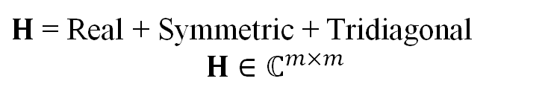
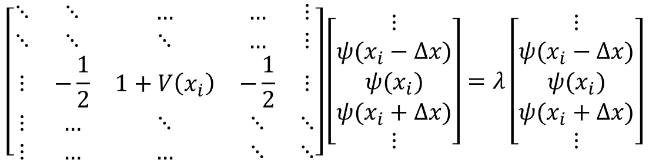
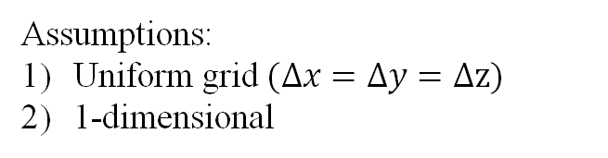

The Problem at hand: (To find $\tilde{n}$ smallest eigenvalues)
$$\left(−\frac{1}{2}∇^{2}+V(x)\right) ψ_{I}(x)=λ_{I}ψ_{I}(x)$$
Assumptions:
Uniform grid $(Δx=Δy=Δz)$
1-dimensional
Finite Difference Method (FDM)
(using 2nd order accurate CDS for Laplacian)
$$\left[\begin{matrix}⋱ & ⋱ & … & … & ⋮ \\ ⋱ & ⋱ & ⋱ & … & ⋮ \\ ⋮ & −\frac{1}{2} & 1+V\left(x_{i}\right) & −\frac{1}{2} & ⋮ \\ ⋮ & … & ⋱ & ⋱ & ⋱ \\ ⋮ & … & … & ⋱ & ⋱\end{matrix}\right]\left[\begin{matrix}⋮ \\ ψ(x_{i}−Δx) \\ ψ(x_{i}) \\ ψ(x_{i}+Δx) \\ ⋮\end{matrix}\right]=λ\left[\begin{matrix}⋮ \\ ψ(x_{i}−Δx) \\ ψ(x_{i}) \\ ψ(x_{i}+Δx) \\ ⋮\end{matrix}\right]$$
$H$ = Real + Symmetric + Tridiagonal
$$H∈ℂ^{m×m}$$
Notes:
Because it includes complexities of both Poisson and Helmholtz

Slide 2
Popular Subspace Iteration (SI) Methods
Krylov Subspace Iteration Method
Fast
Optimal in a certain sense
Requires one starting vector
Not easy to update
Changes in H not allowed
Chebyshev filtered Subspace Iteration Method
Updates are easy
Geared towards subspaces (vs individual eigenvalues)
Tolerates changes in H
Slower
Important note: Both type of methods require only matrix-vector products: Can get superior convergence with shift-and-invert. Issue: cost
We now focus on Chebyshev filtered Subspace Iteration in subsequent slides.

Slide 3
Key Idea in Chebyshev Filtering
Filtering the spectrum for wanted eigenvalues

Slide 4



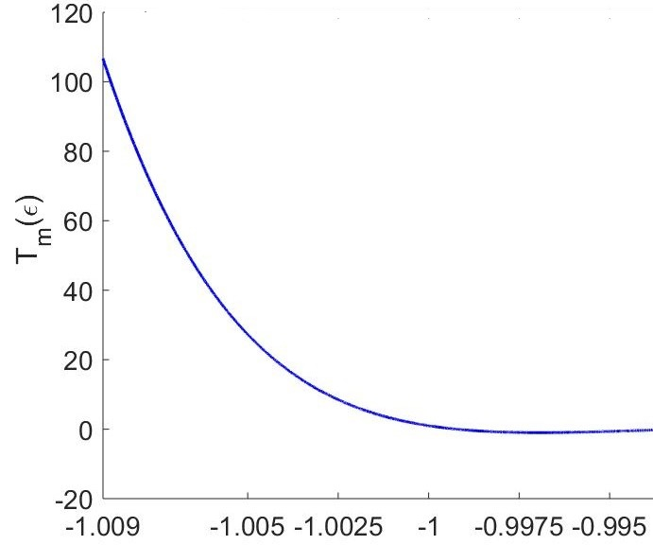







Chebyshev Filtering Step
$$Hψ_{i}=λ_{i}ψ_{i}$$
for i = 1,2,…$\tilde{n}$ smallest eigenvalues
Wanted Spectrum
Unwanted Spectrum
$Ψ∈ℂ^{m×n}$ is trial subspace;
$$\tilde{n}<n<m$$
Chebyshev Filtering:
$$T_{k}\left(H\right)Ψ=Ψ_{F}$$
$$T_{k}\left(H\right)Ψ=\left[2HT_{k−1}\left(H\right)−T_{k−2}\left(H\right)\right]Ψ$$
Scale and Shift
Wanted Spectrum
Unwanted Spectrum

Slide 5
Chebyshev Filtered Subspace Iteration Algorithm(ChFSI)
The Classical Method

Slide 6


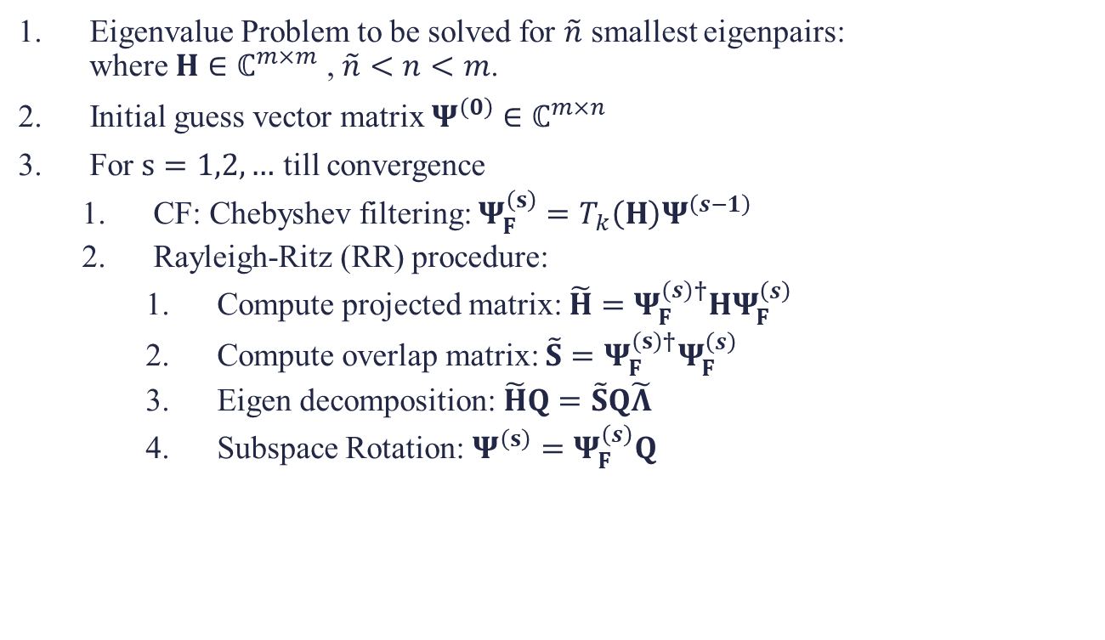
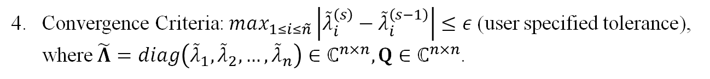


ChFSI Algorithm for computing desired eigenvector/eigenvalue pairs
$$Hψ_{i}=λ_{i}ψ_{i}$$
Eigenvalue Problem to be solved for $\tilde{n}$ smallest eigenpairs: where $H∈ℂ^{m×m}$ , $\tilde{n}<n<m$.
Initial guess vector matrix $Ψ^{\left(0\right)}∈ℂ^{m×n}$
For $s=1,2,…$ till convergence
CF: Chebyshev filtering: $Ψ_{F}^{\left(s\right)}=T_{k}\left(H\right)Ψ^{\left(s−1\right)}$
Rayleigh-Ritz (RR) procedure:
Compute projected matrix: $\tilde{H}=Ψ_{F}^{(s)†}HΨ_{F}^{\left(s\right)}$
Compute overlap matrix: $\tilde{S}=Ψ_{F}^{(s)†}Ψ_{F}^{\left(s\right)}$
Eigen decomposition: $\tilde{H}Q=\tilde{S}Q\tilde{Λ}$
Subspace Rotation: $Ψ^{\left(s\right)}=Ψ_{F}^{\left(s\right)}Q$
$$O(mn^{2})$$
$$O(mn^{2})$$
$$O(n^{3})$$
$$O(mn^{2})$$
Convergence Criteria: $max_{1≤i≤\tilde{n}}\left|{\tilde{λ}}_{i}^{\left(s\right)}−{\tilde{λ}}_{i}^{\left(s−1\right)}\right|≤ε$ (user specified tolerance), where $\tilde{Λ}=diag\left({\tilde{λ}}_{1},{\tilde{λ}}_{2},…,{\tilde{λ}}_{n}\right)∈ℂ^{n×n}, Q∈ℂ^{n×n}$.
Details of each step are described in subsequent slides.

Slide 7
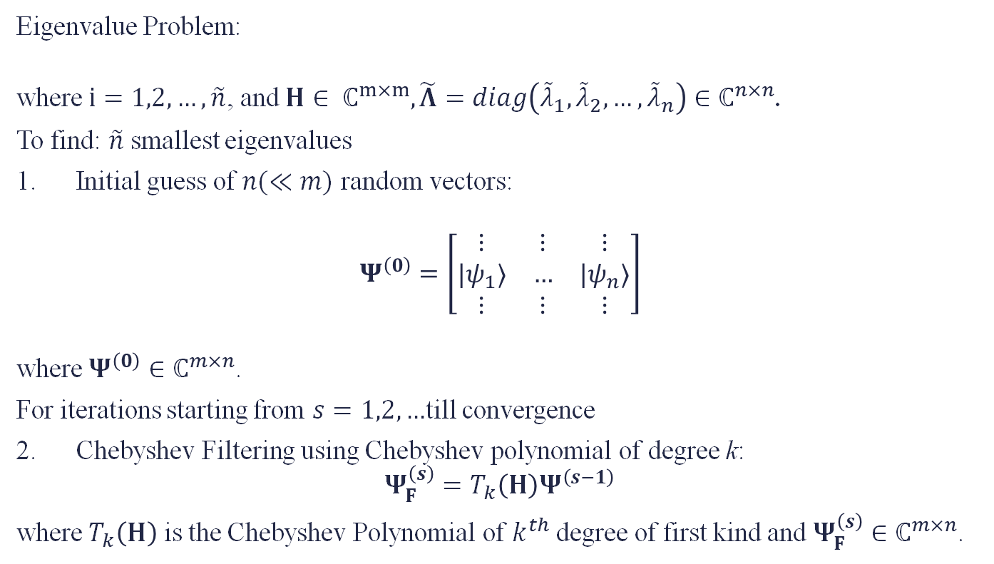
Details of ChFSI
Eigenvalue Problem:
where $i=1,2,…,\tilde{n}$, and $H∈ ℂ^{m×m}, \tilde{Λ}=diag\left({\tilde{λ}}_{1},{\tilde{λ}}_{2},…,{\tilde{λ}}_{n}\right)∈ℂ^{n×n}$.
To find: $\tilde{n}$ smallest eigenvalues
Initial guess of $n(≪m)$ random vectors:
$$Ψ^{\left(0\right)}=\left[\begin{matrix}⋮ & ⋮ & ⋮ \\ {|ψ}_{1}⟩ & … & |ψ_{n}⟩ \\ ⋮ & ⋮ & ⋮\end{matrix}\right]$$
where$Ψ^{\left(0\right)}∈ℂ^{m×n}$.
For iterations starting from $s=1,2,…$till convergence
Chebyshev Filtering using Chebyshev polynomial of degree k:
$$Ψ_{F}^{\left(s\right)}=T_{k}\left(H\right)Ψ^{\left(s−1\right)}$$ where $T_{k}\left(H\right)$ is the Chebyshev Polynomial of $k^{th}$ degree of first kind and $Ψ_{F}^{\left(s\right)}∈ℂ^{m×n}$.
$$Hψ_{i}=λ_{i}ψ_{i}$$

Slide 8
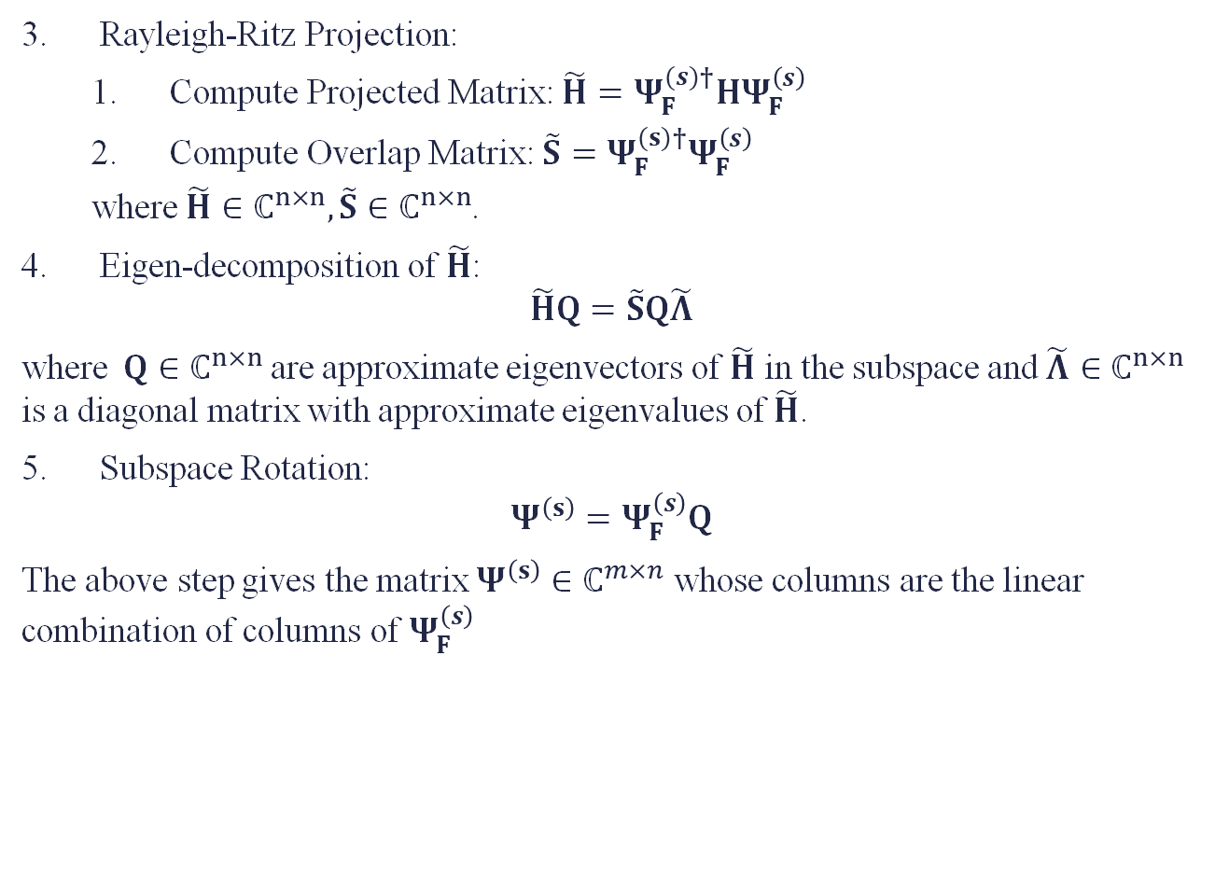
Rayleigh-Ritz Projection:
Compute Projected Matrix: $\tilde{H}=Ψ_{F}^{(s)†}HΨ_{F}^{\left(s\right)}$
Compute Overlap Matrix:$\tilde{S}=Ψ_{F}^{(s)†}Ψ_{F}^{\left(s\right)}$
where $\tilde{H}∈ℂ^{n×n}, \tilde{S}∈ℂ^{n×n}$.
Eigen-decomposition of $\tilde{H}$:
$$\tilde{H}Q=\tilde{S}Q\tilde{Λ}$$ where$Q∈ℂ^{n×n}$ are approximate eigenvectors of $\tilde{H}$ in the subspace and $\tilde{Λ}∈ℂ^{n×n}$ is a diagonal matrix with approximate eigenvalues of $\tilde{H}$.
Subspace Rotation:
$$Ψ^{\left(s\right)}=Ψ_{F}^{\left(s\right)}Q$$ The above step gives the matrix $Ψ^{\left(s\right)}∈ℂ^{m×n}$ whose columns are the linear combination of columns of $Ψ_{F}^{\left(s\right)}$

